Slide 1


Code Refactoring & Bug Fixing
By :
Madhavi . N

Slide 2




About me :
Background ? (B-tech or M-tech) : Madhavi ( BSc(COMPUTERS)), Data Science Course
Why you want to learn Data Science : For FUTURE GROWTH, To get better CAREER OPPORTUNITIES
Any work experience : No
Share your LinkedIn and GitHub profile URLs :
Note : Links are available in hyperlink to above logos

Slide 3
Scenario: -
A team of enthusiastic data scientists embarked on a mission to develop a Note Taking Application using Python, Flask, and HTML. However, their lack of experience in backend development has led to challenges in making the application fully functional. Recognizing your proficiency in backend development, you have been tasked with fixing the broken code and ensuring the application works seamlessly.
Scenario: -
Refactor the existing codebase and ensure the proper functioning of the Note Taking Application. Document all identified bugs during the debugging process. Remember, the task is not about recreating the app from scratch. Your goal is to fix the already existing codebase and make the application work as intended.

Slide 4
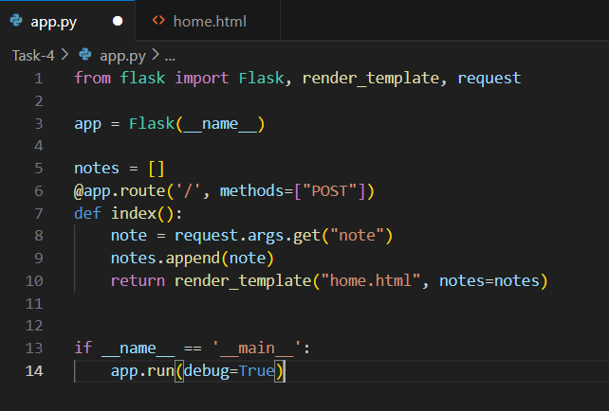
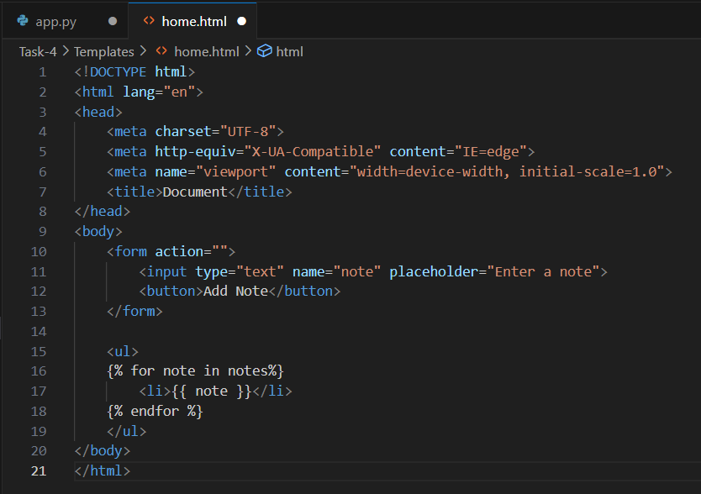
Given code :
Flask code :
HTML code :

Slide 5
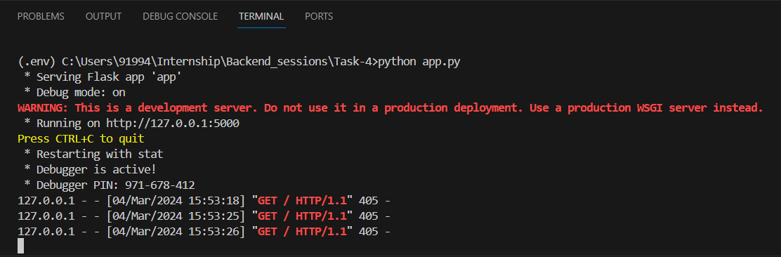
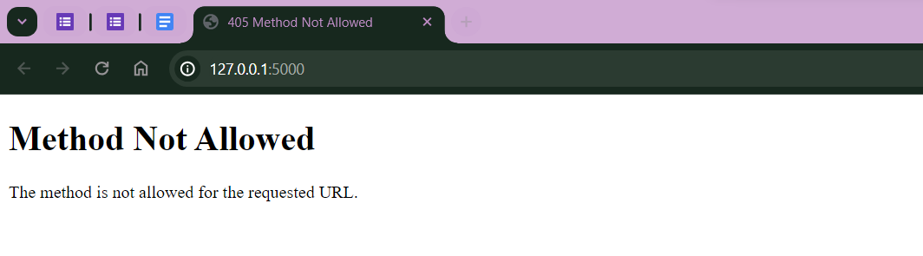
Output :
Terminal :
From terminal, we can know that the status code is 405. Which means, there is a problem in client side.
HTML viewer :
“Method Not allowed” occurs when there is no same methods include in methods section of form tag .

Slide 6

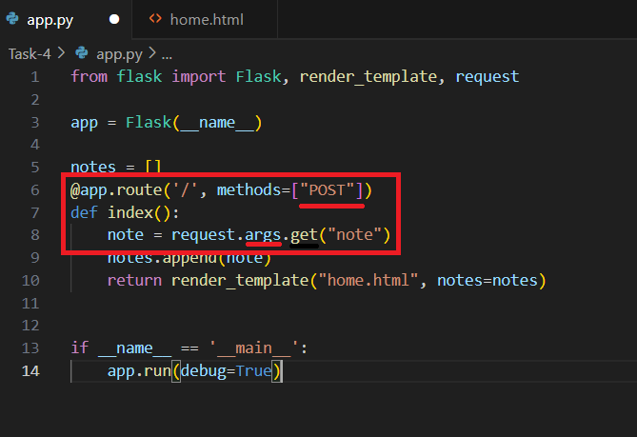
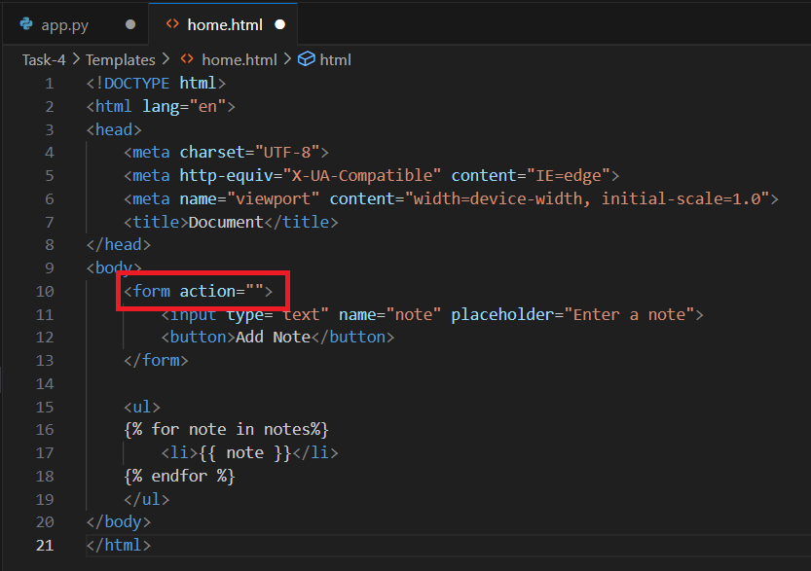
Detected Bugs :
Bug 1 :
Bug 2 :
The marked one is bug because in html code by default it will be a GET method and in flask code we have taken method as POST. Methods should be taken same in both html and flask codes.
The marked is bug because in flask code in route we had given it as “/” but in html code we had given a empty route “ ”. In form tag we need to take POST method for data secure.
Solution :
Solution :
And request.args should be replace by request.form because we are using POST method in HTML. Methods = [“GET”,”POST”]
In form tag : < form action =“/” method = “POST”>

Slide 7
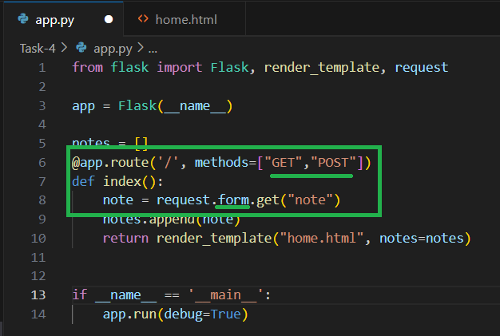
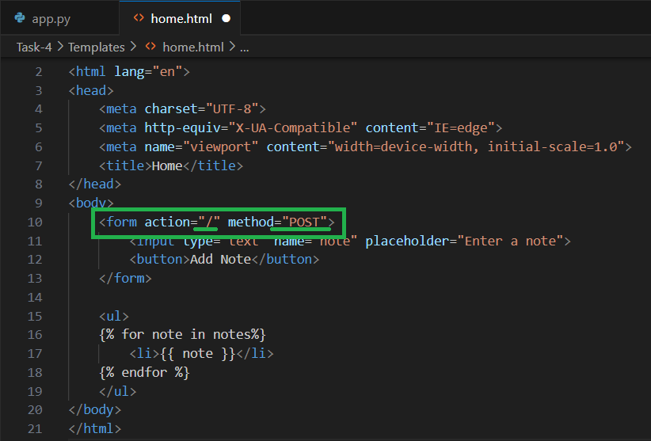
Refactored code :
Flask code :
HTML code :

Slide 8
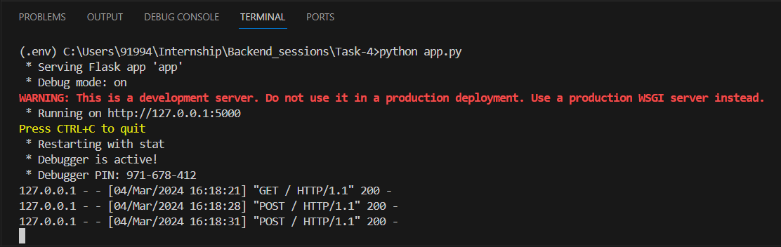
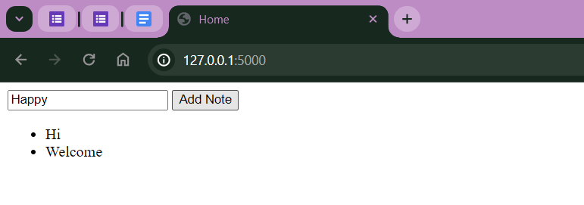
Output :
Terminal :
From terminal, we can know that the status code is 200 which means, we successfully run the app without any errors.
HTML viewer :
After fixing the bugs, this is final output we can expect from the refracted code.

Slide 9


Thank You

